Slide 1
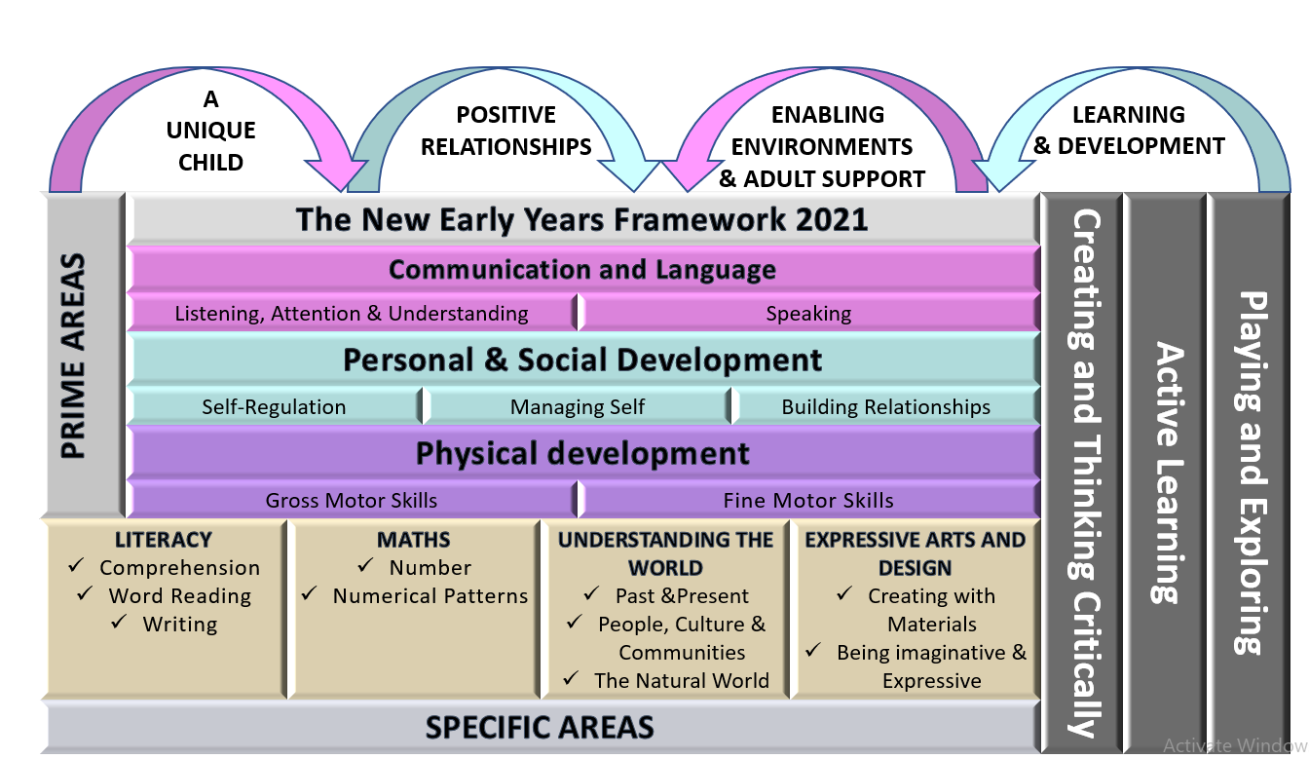
Preschool Long
Term Plan
At Bishops Tawton Primary School we offer a curriculum which is rich in wonder and memorable experiences. We work hard to provide a stimulating environment which provides exciting experiences, promotes challenge, exploration, creativity and a real love of learning. We aim for our children to be independent, confident, believe in themselves and interact positively with others. We understand that play is an integral part of learning and this is at the heart of our Early Years curriculum. Warm and positive relationships between staff and children, consistent routines and strong relationships with parents are key. We recognise the crucial role that early years education has to play in providing firm foundations upon which the rest of a child’s education can be successfully based.

Slide 2
Preschool Long Term Plan
 | Autumn 1 | Autumn 2 | Spring 1 | Spring 2 | Summer 1 | Summer 2
General Themes NB: These themes may be adapted at various points to allow for children’s interests to flow through the provision | All About me! Starting school / my new class / New Beginnings Staying healthy / Food / Human body How have I changed? My family / PSED focus What do I like/dislike? Being kind / staying safe | Autumn Hedgehogs Bonfire Night Diwali Hibernation The Nativity At the Panto Christmas Lists Letters to Father Christmas | Traditional Tales Chinese New Year Three Little Pigs | Growing PLants Plants & Flowers Jack and the Beanstalk Weather / seasons The great outdoors Planting seeds Make a sculpture: Andy Goldsworthy Easter | Minibeasts Habitats Life cycles Mini beasts | Fun at the Seaside! Under the sea Off on holiday / clothes Where in the world shall we go? Pirates Send me a postcard! Marine life Seaside in the past Compare: Now and then! Seaside art
Possible Texts and ‘old favourites’ | Goat Goes to playgroup Olivers Vegetables The Enormous Turnip | Owl Babies Bonfire Poem Hedgehog Howdee Dear Santa Christmas Story / Nativity | Goldilocks The Three Little Pigs The Billy Goats Gruff | The Tiny Seed Oliver’s Vegetables Jack and the Beanstalk One Plastic Bag Jasper’s Beanstalk A seed in Need | The Hungry Caterpillar I love Bugs What am I poems | Lighthouse Keeper’s Lunch The Pirates Next door Commotion in the Ocean Non fiction – Sea Creatures Lost and Found
‘Wow’ moments/Special Days/events | Remembrance Day Harvest Time Birthdays Harvest Meal – Prepare apple crumble | Guy Fawkes / Bonfire Night Christmas Time / Nativity Diwali Road Safety Children in Need Anti- Bullying Week Nativity Christingle Christmas Shop Autumn Walk to the village churchyard. | Chinese Restaurant Taste Chinese Food Dentist Visit – Teeth Cleaning World Book Day | Walk to the park / Picnic Planting seeds Trip to Rosemoor Mother’s Day Queen’s Birthday Science Week Eater Egg Hunt | Watch caterpillars hatch Ugly Bug Ball | Visit to the beach Father’s Day Pirate Day

Slide 3
Preschool Long Term Plan
 | Autumn 1 | Autumn 2 | Spring 1 | Spring 2 | Summer 1 | Summer 2
General Themes | All About me! | Autumn | Traditional Tales | Growing | Mini Beasts | The Sea
Over Arching Principles | Characteristics of Effective Learning Playing and exploring: - Children investigate and experience things, and ‘have a go’. Children who actively participate in their own play develop a larger store of information and experiences to draw on which positively supports their learning Active learning: - Children concentrate and keep on trying if they encounter difficulties. They are proud of their own achievements. For children to develop into self-regulating, lifelong learners they are required to take ownership, accept challenges and learn persistence. Creating and thinking critically: - Children develop their own ideas and make links between these ideas. They think flexibly and rationally, drawing on previous experiences which help them to solve problems and reach conclusions.
Over Arching Principles | Unique Child: Every child is unique and has the potential to be resilient, capable, confident and self-assured. Positive Relationships: Children flourish with warm, strong & positive partnerships between all staff and parents/carers. This promotes independence across the EYFS curriculum. Children and practitioners are NOT alone – embrace each community. Enabling environments: Children learn and develop well in safe and secure environments where routines are established and where adults respond to their individual needs and passions and help them to build upon their learning over time. Learning and Development: Children develop and learn at different rates (not in different ways as it stated 2017). We must be aware of children who need greater support than others. PLAY: At Bishops Tawton Primary School, we understand that children learn best when they are absorbed, interested and active. We understand that active learning involves other children, adults, objects, ideas, stimuli and events that aim to engage and involve children for sustained periods. We believe that Early Years education should be as practical as possible and therefore , we are proud that our EYFS setting has an underlying ethos of ‘Learning through play. PLAY is essential for children’s development across all areas. Play builds on children’s confidence as they learn to explore, to relate to others around them and develop relationships , set their own goals and solve problems. Children learn by leading their own play and by taking part in play which is guided by adults.’. EYFS Team We will ensure that all children learn and develop well and are kept healthy and safe at ALL times.

Slide 4
Preschool Long Term Plan
 | Autumn 1 | Autumn 2 | Spring 1 | Spring 2 | Summer 1 | Summer 2
General Themes | All About me! | Autumn | Traditional Tales | Growing | Mini Beasts | The Sea
Our Values | Mutual respect We are all unique. We respect differences between different people and their beliefs in our community, in this country and all around the world. All cultures are learned , respected, and celebrated. | Mutual Tolerance Everyone is valued, all cultures are celebrated and we all share and respect the opinions of others. Mutual tolerance of those with different faiths and beliefs and for those without faith. | Rule of law We all know that we have rules at school that we must follow. We know who to talk to if we do not feel safe. We know right from wrong. We recognise that we are accountable for our actions. We must work together as a team when it is necessary. | Individual liberty We all have the right to have our own views. We are all respected as individuals. We feel safe to have a go at new activities. We understand and celebrate the fact that everyone is different. | Democracy We all have the right to be listened to. We respect everyone and we value their different ideas and opinions. We have the opportunity to play with who we want to play with. We listen with intrigue and value and respect the opinions of others. | Recap all British Values Fundamental British Values underpin what it is to be a citizen in a modern and diverse Great Britain valuing our community and celebrating diversity of the UK. Fundamental British Values are not exclusive to being British and are shared by other democratic countries.
Assessment opportunities | Baseline Assessments – In House On going observations of WOW moments recorded on 2 Simple. 2 Year Old Check | On going assessments Baseline analysis Parents evening Mini Reports EYFS team meetings In house moderation 2 Year Old Check | Moderation EYFS team meetings Phase meeting and internal moderations 2 Year Old Check | Pupil progress meetings Parents evening Mini Reports EYFS team meetings Update Termly Assessments – On Track, Not on Track 2 Year Old Check | EYFS team meetings On going assessments 2 Year Old Check | End of Year Reports Transition Documents Parents evening EYFS team meetings for moderation. 2 Year Old Check
Parental Involvement | Parents Meetings Harvest Assembly Home / School Agreement Phonics workshop WOW Slips Home learning Informal chats at drop off | WOW Slips Nativity Christingle Mini Report Christmas Crafts Informal chats at drop off | WOW Slips Parents Meetings Informal chats at drop off | WOW Slips Garden Centre Mini Reports Easter Craft Morning Informal chats at drop off | WOW Slips Ugly Bug Ball Parents Meetings Informal chats at drop off | WOW Slips Pirate Day End of Year Reports Parents Evening Parent’s Picnic Sports Day Informal chats at drop off

Slide 5
Preschool Long Term Plan
 | Autumn 1 | Autumn 2 |  | Spring 1 |  | Spring 2 |  | Summer 1 |  | Summer 2
General Themes | All About me! | Autumn |  | Traditional Tales |  | Growing |  | MiniBeasts |  | The Sea
Communication and Language | The development of children’s spoken language underpins all seven areas of learning and development. Children’s back-and-forth interactions from an early age form the foundations for language and cognitive development. The number and quality of the conversations they have with adults and peers throughout the day in a language-rich environment is crucial. By commenting on what children are interested in or doing, and echoing back what they say with new vocabulary added, practitioners will build children's language effectively. Reading frequently to children, and engaging them actively in stories, non-fiction, rhymes and poems, and then providing them with extensive opportunities to use and embed new words in a range of contexts, will give children the opportunity to thrive. Through conversation, story-telling and role play, where children share their ideas with support and modelling from their teacher, and sensitive questioning that invites them to elaborate, children become comfortable using a rich range of vocabulary and language structures.
Whole EYFS Focus – C&L is developed throughout the year through high quality interactions, daily group discussions, sharing circles, PSHE times, stories, singing, speech and language interventions, Pie Corbett T4W actions, EYFS productions, assemblies and weekly interventions. Daily story time | Welcome to EYFS Settling in activities Making friends Children talking about experiences that are familiar to them What are your passions / goals / dreams? This is me! Rhyming and alliteration Familiar Print Sharing facts about me! Mood Monsters Shared stories All about me! Model talk routines through the day. For example, arriving in school: “Good morning, how are you?” |  | Tell me a story! Settling in activities Develop vocabulary Discovering Passions Tell me a story - retelling stories Story language Listening and responding to stories Following instructions Takes part in discussion Understand how to listen carefully and why listening is important. Use new vocabulary through the day. Choose books that will develop their vocabulary. |  | Tell me why! Using language well Ask’s how and why questions… Discovering Passions Retell a story with story language Story invention – talk it! Ask questions to find out more and to check they understand what has been said to them. Describe events in some detail. Listen to and talk about stories to build familiarity and understanding. Learn rhymes, poems and songs. |  | Talk it through! Settling in activities Describe events in detail – time connectives Discovering Passions Understand how to listen carefully and why listening is important. Use picture cue cards to talk about an object: “What colour is it? Where would you find it? Sustained focus when listening to a story |  | What happened? Settling in activities Discovering Passions Re-read some books so children learn the language necessary to talk about what is happening in each illustration and relate it to their own lives |  | Time to share! Show and tell Weekend news Discovering Passions Read aloud books to children that will extend their knowledge of the world and illustrate a current topic. Select books containing photographs and pictures, for example, places in different weather conditions and seasons.

Slide 6
Preschool Long Term Plan
REFLECTION | Autumn 1 | Autumn 2 |  | Spring 1 |  |  | Spring 2 |  | Summer 1 |  | Summer 2
General Themes | All About me! | Autumn |  | Traditional Tales |  |  | Growing |  | Mini Beasts |  | The Sea
Personal, Social and Emotional Development | Children’s personal, social and emotional development (PSED) is crucial for children to lead healthy and happy lives, and is fundamental to their cognitive development. Underpinning their personal development are the important attachments that shape their social world. Strong, warm and supportive relationships with adults enable children to learn how to understand their own feelings and those of others. Children should be supported to manage emotions, develop a positive sense of self, set themselves simple goals, have confidence in their own abilities, to persist and wait for what they want and direct attention as necessary. Through adult modelling and guidance, they will learn how to look after their bodies, including healthy eating, and manage personal needs independently. Through supported interaction with other children, they learn how to make good friendships, co-operate and resolve conflicts peaceably. These attributes will provide a secure platform from which children can achieve at school and in later life.
Managing Self Self - Regulation | New Beginnings See themselves as a valuable individual. Being me in my world Class Rule Rules and Routines Supporting children to build relationships Dreams and Goals |  | Getting on and falling out. How to deal with anger Emotions Self - Confidence Build constructive and respectful relationships. Ask children to explain to others how they thought about a problem or an emotion and how they dealt with it. |  | Good to be me Feelings Learning about qualities and differences Celebrating differences Identify and moderate their own feelings socially and emotionally. Encourage them to think about their own feelings and those of others by giving explicit examples of how others might feel in particular scenarios |  |  | Relationships What makes a good friend? Healthy me Random acts of Kindness Looking after pets Looking After our Planet Give children strategies for staying calm in the face of frustration. Talk them through why we take turns, wait politely, tidy up after ourselves and so on | Looking after others | Looking after others Friendships Dreams and Goals Show resilience and perseverance in the face of challenge. Discuss why we take turns, wait politely, tidy up after ourselves and so on. | Taking part in sports day - Winning and loosing Changing me Look how far I've come! Model positive behaviour and highlight exemplary behaviour of children in class, narrating what was kind and considerate about the behaviour.
Self - Regulation Link to Behaviour for Learning | Show an understanding of their own feelings and those of others, and begin to regulate their behaviour accordingly. Set and work towards simple goals, being able to wait for what they want and control their immediate impulses when appropriate. Give focused attention to what the teacher says, responding appropriately even when engaged in activity, and show an ability to follow instructions involving several ideas or actions. Controlling own feelings and behaviour. Applying personalised strategies to return to a state of calm. Being able to curb impulsive behavior. Being able to concentrate on a task. Being able to ignore distractions. Behaving in ways that are pro-social. Planning. Thinking before acting. Delaying gratification. Persisting in the face of difficulty. |  |  |  |  |  |  | “Self-regulatory skills can be defined as the ability of children to manage their own behaviour and aspects of their learning. In the early years, efforts to develop self-regulation often seek to improve levels of self-control and reduce impulsivity. Activities typically include supporting children in articulating their plans and learning strategies and reviewing what they have done.” Education Endowment Foundation.
Building Learning POwer | Working Together I understand I have a role to play when working with others. I can share my ideas confidently, even if I am not sure they are right. |  | Independence I can choose the right equipment to help me with my learning. I can plan my learning to reach my goal. |  |  | Resilience I can try different ways to solve a problem. I can ask for help when I need it. I can try again even if it didn’t work the first time. |  | Risk taking I can understand it’s okay to make mistakes. I can try new things even when its hard. |  | Curiosity/Creativity I can ask questions to further my learning. I can explore and improve my ideas. | Reflection I can say what I like and explain why I like it. I can explain how I feel about my learning. I can explain my learning and decide what to do next.

Slide 7
Preschool Long Term Plan
 | Autumn 1 | Autumn 2 | Spring 1 | Spring 2 | Summer 1 | Summer 2
General Themes | All About me! | Autumn | Traditional Tales | Growing | Minibeasts | The Sea
Physical development Fine motor Continuously check the process of children’s handwriting (pencil grip and letter formation, including directionality). Gross motor | Physical activity is vital in children’s all-round development, enabling them to pursue happy, healthy and active lives. Gross and fine motor experiences develop incrementally throughout early childhood, starting with sensory explorations and the development of a child’s strength, co-ordination and positional awareness through tummy time, crawling and play movement with both objects and adults. By creating games and providing opportunities for play both indoors and outdoors, adults can support children to develop their core strength, stability, balance, spatial awareness, co-ordination and agility. Gross motor skills provide the foundation for developing healthy bodies and social and emotional well-being. Fine motor control and precision helps with hand-eye co-ordination, which is later linked to early literacy. Repeated and varied opportunities to explore and play with small world activities, puzzles, arts and crafts and the practice of using small tools, with feedback and support from adults, allow children to develop proficiency, control and confidence.
Fine motor | Begin to show a preference for a dominant hand Activities to promote fine motor control cutting, playdough, tweezers, . | Independently put on own coats with some support for zipper and buttons. Use mark making resources with increasing independence. (Snip with scissors, paint with paint brush). | Mark make in sensory trays and copy different patterns. To use a comfortable grip when mark making using pencils and pens. To know that they need to use tools with dominant hand. | To hold the pencil correctly using the tripod grip. To begin to form letters and numbers of personal importance (name, age, house number). To know how to use one handed tools effectively (stapler, hole punch) | To hold the pencil correctly using the tripod grip forming some letters correctly. To use scissors to make straight, zigzag and circular snips using one hand. To know how to pass paper through hand when cutting objects. | To hold the pencil correctly using the tripod grip forming most letters correctly. To independently write their name. To confidently use scissors and other tools independently. Confidently get dressed and undressed.
Gross motor | Take care of toileting needs independently . To climb apparatus safely. To know that washing hands is important before and after we eat. To show independence whilst easting and drinking. Being able to self feed/open containers with help. To use alternate feet when climbing apparatus, | Copy dance moves and move to different kinds of rhythms. Know how to move to different rhythms. (Slow music and fast on quicker beats). | To move in different ways, running, jumping, skipping, galloping. To fill containers with different materials, sand, water, Show coordination in pouring from one to the other. To show independence in self heal, getting dressed, toileting. | To follow a sequence of movements to music and rhythm. Use balancing apparatus. | To run skillfully and be able to negotiate space. To be aware of obstacles whilst running, riding a bike etc and demonstrate some special awareness. | To take part in group games with support from an adult. To move confidently and safely in a range of ways avoiding obstacles, running, hopping etc.

Slide 8
Preschool Long Term Plan
 | Autumn 1 | Autumn 2 | Spring 1 | Spring 2 | Summer 1 | Summer 2
General Themes | All About me! | Autumn | Traditional Tales | Growing | Minibeasts | The Sea
Literacy Developing a passion for reading Children participate in daily letters and sounds sessions, the younger 2-3 Age children take part in separate group led by EYFS practitioner. Children have access to a range of reading books in their continuous provision both inside and outside the classroom. | It is crucial for children to develop a life-long love of reading. Reading consists of two dimensions: language comprehension and word reading. Language comprehension (necessary for both reading and writing) starts from birth. It only develops when adults talk with children about the world around them and the books (stories and non-fiction) they read with them, and enjoy rhymes, poems and songs together. Skilled word reading, taught later, involves both the speedy working out of the pronunciation of unfamiliar printed words (decoding) and the speedy recognition of familiar printed words. Writing involves transcription (spelling and handwriting) and composition (articulating ideas and structuring them in speech, before writing)
Literacy Comprehension | Joins in with rhymes, copies and repeats rhyme and tempo. Enjoys sharing books with an adult. Author Study – Jill Murphy | Copies finger movements and actions in rhymes. Pays attention to the print and pictures in the book. Show an awareness of print in the environment. Author Study – Julia Donaldson | Sport and suggest rhymes when reading rhyming books. Have a favourite story/rhyme. Has a favourite story and seeks it out to share. Author Study – Traditional Tales | Understand the five key concepts about print: - print has meaning - print can have different purposes - we read English text from left to right and from top to bottom - the names of the different parts of a book Repeats repeated words or phrases from familiar stories. Author Study – Emily Gravett | Sings songs and says rhymes independently when playing. Recognise when words begin with the same letter. Develops play around favourite stories using props. Author Study – Eric Carle | Engage in extended conversations about what they have read and make links to own experiences. Asks questions about the books that they read. Learn new vocabulary. Author study – Oliver Jeffers
Word Reading | Phonics – Letter and Sounds Phase 1 Aspect 2 Instrumental Sounds | Phonics – Letter and Sounds Phase 1 Aspect 3 Body Percussion | Phonics – Letter and Sounds Phase 1 Aspect 4 Rhythm and Rhyme | Phonics – Letter and Sounds Phase 1 Aspect 5 Voice Sounds | Phonics – Letter and Sounds Phase 1 Aspect 6 Alliteration | Phonics – Letter and Sounds Phase 1 Aspect 7 Oral Blending and Segmenting Aspect 1 – Environmental sounds

Slide 9
Preschool Long Term Plan
 | Autumn 1 | Autumn 2 | Spring 1 | Spring 2 | Summer 1 | Summer 2
General Themes | All About me! | Autumn | Traditional Tales | Growing | Mini Beasts | The Sea
Writing | Texts as a Stimulus: Nursery Rhymes Goat Goes to School Enjoys drawing freely | Texts as a Stimulus: Owl Babies Add meanings to some drawings. | Texts as a Stimulus: Jaspers Beanstalk Make marks which represent their name. | Texts as a Stimulus: Titch Use some knowledge of print/letters in their play. For example shopping lists, cards, labels. | Texts as a Stimulus: The Very Hungry Caterpillar Write some or all of their name. . | Texts as a Stimulus: Sharing a Shell Write some letters accurately.

Slide 10
Preschool Long Term Plan
 | Autumn 1 | Autumn 2 | Spring 1 | Spring 2 | Summer 1 | Summer 2
General Themes | All About me | Autumn | Traditional Tales | Growing | Minibeasts | The sea
Maths Children take part in a daily Maths session , the younger 2-3 Year Old children are taught in a separate group with an EYFFS practitioner. The children have access to Maths activities in the continuous provision. | Developing a strong grounding in number is essential so that all children develop the necessary building blocks to excel mathematically. Children should be able to count confidently, develop a deep understanding of the numbers to 10, the relationships between them and the patterns within those numbers. By providing frequent and varied opportunities to build and apply this understanding - such as using manipulatives, including small pebbles and tens frames for organising counting - children will develop a secure base of knowledge and vocabulary from which mastery of mathematics is built. In addition, it is important that the curriculum includes rich opportunities for children to develop their spatial reasoning skills across all areas of mathematics including shape, space and measures. It is important that children develop positive attitudes and interests in mathematics, look for patterns and relationships, spot connections, ‘have a go’, talk to adults and peers about what they notice and not be afraid to make mistakes.
Maths | Recognise and count numbers to 3 Show 1-1 Matching when counting 0-3 Show finger numbers 0-3 Count out a group of 3 objects. Talk about and explore 2D shapes. Show an awareness of number rhyme, counting in sequence. | Match a numeral to a number of objects. Count out a group of 5 objects. Demonstrate an understanding of 1-1 matching when counting 0-5. Talk about and explore 2d shapes. | Count out a group of up to 5 objects. One more one less Rapid recall of numbers Show finger numbers 0-5. Begin to experiment with mark making to form numbers. Talk about and explore pattern in the environment Explore mathematical language when talking about shape – sides, corners, flat, round. | Compare groups of numbers. Use language of fewer/more than. Compare objects according to weight and distance. Develop rapid recall of numbers. Count in sequence. Use positional language under/behind, on top of. Talk about own patterns using a range of objects and resources. | Solve practical problems using numbers up to 5. Select shapes appropriately in play to make models, pictures and enclosures. Develop rapid recall of numbers. Make comparisons between size, length, weight and capacity. Begin to describe a sequence of events accurately. Notice and correct an error in a pattern. Recall simple facts about a familiar journey. | Depth of numbers within 20 Explore numbers and strategies •Recognise and extend patterns •Apply number, shape and measures knowledge •Count forwards and backwards Numbers beyond 20 One more one less •Estimate and count •Grouping and sharing | Count, order and recognize numbers 0-10 in and out of sequence. Name and describe 2d shapes. Name some common 3d shapes. Compare and order objects according to size and distance. Begin to describe a sequence of events accurately. Recall facts about a simple journey . Begin to describe a sequence of events real or fictional using words such as first, next, then.

Slide 11
Preschool Long Term Plan
 | Autumn 1 | Autumn 2 |  | Spring 1 | Spring 2 |  | Summer 1 | Summer 2
General Themes | All About me! | Autumn |  | Traditional tales | growing |  | Minibeasts | The sea
Understanding the world RE / Festivals | Understanding the world involves guiding children to make sense of their physical world and their community. The frequency and range of children’s personal experiences increases their knowledge and sense of the world around them – from visiting parks, libraries and museums to meeting important members of society such as police officers, nurses and firefighters. In addition, listening to a broad selection of stories, non-fiction, rhymes and poems will foster their understanding of our culturally, socially, technologically and ecologically diverse world. As well as building important knowledge, this extends their familiarity with words that support understanding across domains. Enriching and widening children’s vocabulary will support later reading comprehension.
Understanding the world RE / Festivals Our RE Curriculum enables children to develop a positive sense of themselves and others and learn how to form positive and respectful relationships. They will begin to understand and value the differences of individuals and groups within their own community. Children will have opportunity to develop their emerging moral and cultural awareness. | To know about family structures and be able to talk about who is part of their family. To draw sillouettes and orally label body parts. Identify some similarities between themselves and their peers. To make self portraits. To talk about body parts and the function of each body part. | Can talk about what they have done with their families during Christmas’ in the past. Show photos of how Christmas used to be celebrated in the past. Use world maps to show children where some stories are based. Use the Jolly Postman to draw information from a map and begin to understand why maps are so important to postmen. Share different cultures versions of famous fairy tales. To introduce children to a range of fictional characters and creatures from stories and to begin to differentiate these characters from real people in their lives. Stranger danger (based on Jack and the beanstalk). Talking about occupations and how to identify strangers that can help them when they are in need. | To know that everyone has a birthday ad they are usually celebrated in a similar manner around the world. To know that some celebrations are specific to some cultures. Operate simple equipment (CD Player, IWB, remote control). Trip to Church for Christingle service/Nativity | To use the computer to perform a simple task. To talk about where food comes from and bake a range of things. To know that different animals produce food that we consume. | Plant own seeds and check how they are growing. Continue to use the computer and gain confidence using the mouse. To learnt about how Christians celebrate Easter. To use senses to explore the world around them. To know that every living being has a lift cycle and they change in shape. | To make comparisons between habitats of mini beats, farm animals and wild animals. To talk about the life cycle of animals/mini beasts. To make own habitats using a range of resources. To use their senses to explore the world around them. | Use Handa’s Surprise to explore a different country. Discuss how they got to school and what mode of transport they used. Introduce the children to a range of transport and where they can be found. Look at the difference between transport in this country and one other country. Encourage the children to make simple comparisons. Use bee-bots on simple maps. Encourage the children to use navigational language. Can children talk about their homes and what there is to do near their homes? Look out for children drawing/painting or constructing their homes. Encourage them to comment on what their home is like. Show photos of the children’s homes and encourage them to draw comparisons. Environments – Features of local environment Maps of local area Comparing places on Google Earth – how are they similar/different? Introduce the children to NASA and America. Introduce children to significant figures who have been to space and begin to understand that these events happened before they were born. Can children differentiate between land and water. | To understand where dinosaurs are now and begin to understand that they were alive a very long time ago. Learn about what a palaeontologist is and how they explore really old artefacts. Introduce Mary Anning as the first female to find a fossil. Materials: Floating / Sinking – boat building Metallic / non-metallic objects Seasides long ago – Magic Grandad | To use a programmable Beebot. To talk about similarities and differences of materials. Know that there are different countries in the world and talk about the differences they have experienced or seen in photos.
RE / Festivals RE is a compulsory part of the basic curriculum for all Reception age pupils, and should be taught according to this Agreed Syllabus for RE. | Which stories are special and why? | Which people are special and why? Diwali Hannukah Christmas | Which people are special and why? Diwali Christmas | What places are special and why? Shrove Tuesday St David’s Day Chinese New Year | What times are special and why? Palm Sunday Passover Easter | Being special: where do we belong? Eid Shavuot | Being special: where do we belong? Eid Shavouot | What is special about our world? | What is special about our world? Olympics World Cup Tennis

Slide 12
Preschool Long Term Plan
 | Autumn 1 | Autumn 2 | Spring 1 | Spring 2 | Summer 1 | Summer 2
General Themes | All About me! | Autumn | Traditional tales | growing | minibeasts | The sea
Expressive Arts and Design Painting, 3D modelling, messy play, collage, cutting, drama, role play, threading, moving to music, clay sculptures, following music patterns with instruments, singing songs linked to topics, making instruments, percussion. Whole school Arts Week held in the Summer Term, with visits/workshops from artists and an open gallery for parents. | The development of children’s artistic and cultural awareness supports their imagination and creativity. It is important that children have regular opportunities to engage with the arts, enabling them to explore and play with a wide range of media and materials. The quality and variety of what children see, hear and participate in is crucial for developing their understanding, self-expression, vocabulary and ability to communicate through the arts. The frequency, repetition and depth of their experiences are fundamental to their progress in interpreting and appreciating what they hear, respond to and observe. Give children an insight into new musical worlds. Invite musicians in to play music to children and talk about it. Encourage children to listen attentively to music. Discuss changes and patterns as a piece of music develops.
Expressive Arts and Design Painting, 3D modelling, messy play, collage, cutting, drama, role play, threading, moving to music, clay sculptures, following music patterns with instruments, singing songs linked to topics, making instruments, percussion. Children to produce a piece of art work each half term to be displayed for ‘Celebration wall’ for school / parents to show how drawings have developed - lots of links to Fine Motor Skills. Children to explain their work to others. Children will have opportunities to learn and perform songs, nursery rhymes and poetry linked to their work / interests and passions. | Join in with songs; beginning to mix colours, join in with role play games and use resources available for props; build models using construction equipment. Home corner role play area. Sing call-and-response songs, so that children can echo phrases of songs you sing. Self-portraits, junk modelling, take picture of children’s creations and record them explaining what they did. Exploring sounds and how they can be changed, tapping out of simple rhythms. Provide opportunities to work together to develop and realise creative ideas. | To explore what happens when you mix colours together. Begin to join construction pieces together to build and balance. Pet rescue Role play area Firework pictures, Christmas decorations, Christmas cards, Divas, Christmas songs/poems Make Christmas cards and decorations for friends and family using a variety of media. The use of story maps, props, puppets & story bags will encourage children to retell, invent and adapt stories. Role Play Party’s and Celebrations Role Play of The Nativity | Children will be encouraged to select the tools and techniques they need to assemble materials that they are using e.g creating animal masks. To play instruments with increasing control. To know that colours can be mixed to make new colours. To construct with a purpose safely. Little Pigs House Role play | Engage with role play by putting a stick puppet of different parts of the story. Sing familiar nursery rhymes. Use tools for a purpose. Make different textures; make patterns using different colours To create recognisable representations of objects. Garden Centre role play | Use available resources to create props to support role play. To show different emotions in pictures clearly. To draw with increasing control representing features and detail clearly. Bug Hunt Role play Doctors role play | To show confidence in choice of media when creating a model or a picture. To construct using bricks or blocks to make an enclosure. Explore different materials freely, using them with a purpose. Pirate ship role play Ice cream shop role play

Slide 13
Continuous Provision Resources/Plan
Inside Provision. | Reading Area: Resources: Cushions, teddies, rug, chairs, topic books, rhyming books, decodable books, fiction and non fiction. Nursery rhyme cards. Emotions cards. Possible exploration/skills: Sharing books, independently looking at books, sound recognition, concept of print, story telling. | Mark Making: Resources: paper, felt tips, pencils, rubbers, sharpeners, crayons, pens, highlighters, craft materials, material, glue sticks, scissors, sellotape, masking tape, stickers. Possible exploration/skills: Gross motor, fine motor, name writing, scissor skills, joining materials, colour recognition, mixing, Process art. | Interactive whiteboard Resources: Lap top, interactive whiteboard, interactive whiteboard pens. Number blocks, nursery rhymes, stories or something like that or at the end of the day dancing or yoga. We research questions the children might have, watch celebrations from around the world etc. The children can use the pens for mark making or accessing different programmes | Small world/construction Resources: Zoo, farm, dinosaur, people, super heroes, insects, British wildlife, cars and vehicles all different types and sizes, rescue vehicles and buildings, aeroplanes and helicopters, trains and track, foam bricks, wooden bricks, tinker table with tools, people, fabric, helmets, clipboards. | Malleable/Funky Fingers Resources: Playdough cutter, rolling pins, cake making tools, threading, nuts and bolts, peg boards and pegs. Possible exploration/skills: Sensory play, fine motor. | Home corner Resources: Kitchens, drawers, table and chair, pots and pans, plates, bowls etc, cutlery, cooking utensils, food, clock, storage boxes shopping baskets, diary/books, pens, phones, cameras, lap top, dolls, clothes, nappies, potty, push chair, crib, high chair, dog, basket and lead. Dressing up clothes and shoes, bags, jewellery, hats and helmets | Making Area Resources: Junk materials, boxes, plastic, paper, card, attaching resources – masking tape, glue, staplers, hole punch, split pins. Embelishments: sequins, feathers, lolly sticks, matchsticks, beads. | Maths Area: Resources: number line with dots on wall, small parts, sorting objects, sorting bowls, stacking cups, shape sorters, 2 d shapes, abacus, chequers board, weighing scales, number cars, playing cards, calculators, phones, jigsaws, wooden puzzles, meter ruler, shoe measurer, giant foam dice. | PSHE: Feeling books, weekly vote, names to vote with.
Outside Provision | Gravel Resources: Gravel, painted stones, number stones, digger, spades, containers, pulley, wheelbarrow, trolley, high viz vests, helmets, spirit level, small planks, construction vehicles and signage. Possible exploration/skills: Gross motor, fine motor, role play, recognising; numbers, letters, colours, shapes | Exploration kitchen Resources: Kitchen, bowls, utensils, cutlery, scissors, empty hand wash bottles with coloured water, fruit and vegetables, herbs and leaves. Possible exploration/skills: Scissor skills, cutting skills, sensory play, gross motor, filling and emptying., capacity | Stage Resources: pallet, seats, musical instruments, pom poms, costumes. Possible exploration/skills: Role play, singing and dancing, small world play | Construction Area Resources: palette, plastic trays, planks, tyres. Possible exploration/skills: Gross motor, problem solving, working together | Book nook Resources: Selection of books changed weekly, cushions, beanbag, sofa and chairs. Possible exploration/skills: Sharing books, independently looking at books, role play, recognising sounds, concepts of print, story telling | Mark Making Resources: chalk boards, chalk, containers and brushes. Possible exploration/skills: Gross motor, fine motor | Sand/Water Resources: Sand and water trays. Contents changed weekly. Sieves, tweezers, pouring, small world, guttering, pipets, funnels, Possible exploration/skills: Fine motor, gross motor, small world play, role play | Bikes Resources: Bikes, pushchairs, scooters, road signs, timer. Possible exploration/skills: Gross motor control | Planters Resources: Planter with soil, herbs, flowers, vegetables. Possible exploration/ skills: Planting and caring for plants
 | Sports equipment Resources: Footballs, small balls, rackets, cricket bats, cup stilts, giant snakes and ladders, giant numeracy dice, bean bags, bean bag animals, quoits hoops. Possible exploration/skills: Physical skills, sorting and matching, counting | Climbing frame/slide Possible exploration/skills: Physical skills, climbing, balancing, risk taking. | Painting Resources: Easel paint, brushes of different sizes. Possible exploration/skills: Gross motor, sensory play | Tuff spot Small world/sensory play | Dinosaur world Resources: Tyres with grass and gravel, dinosaurs, signage. Possible exploration/skills: Role play, letter recognition. | Role Play Ongoing role play area changed to children’s interests. | Log circle Logs, chippings. Possible explorations/skills – Story telling, circle games, forest school skills.

Slide 14
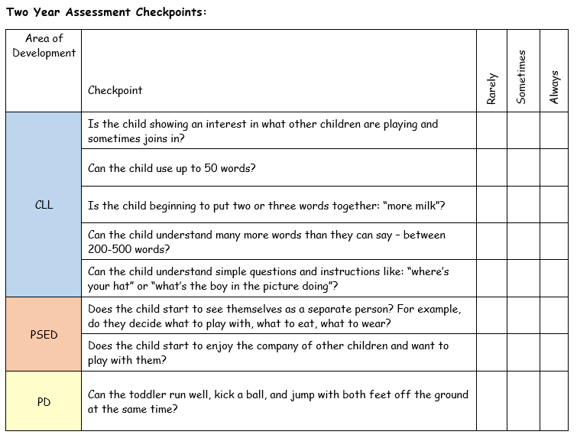
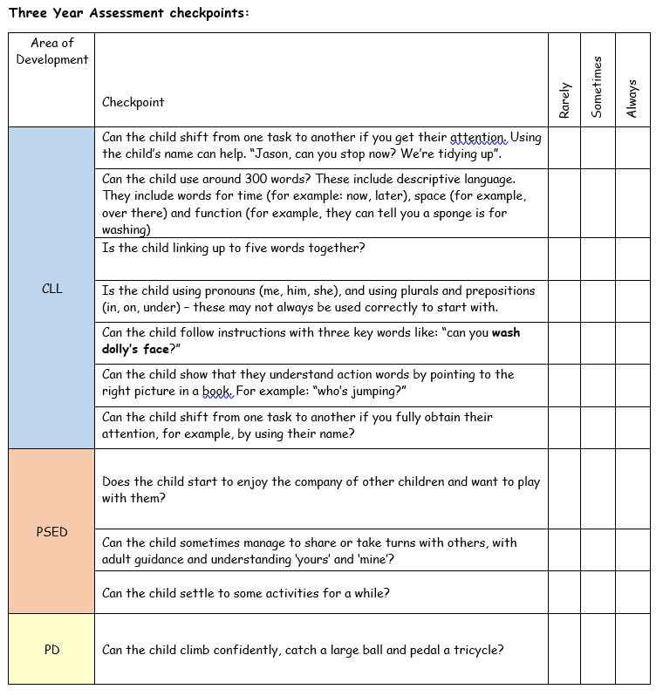
Preschool Long Term Plan

Slide 15
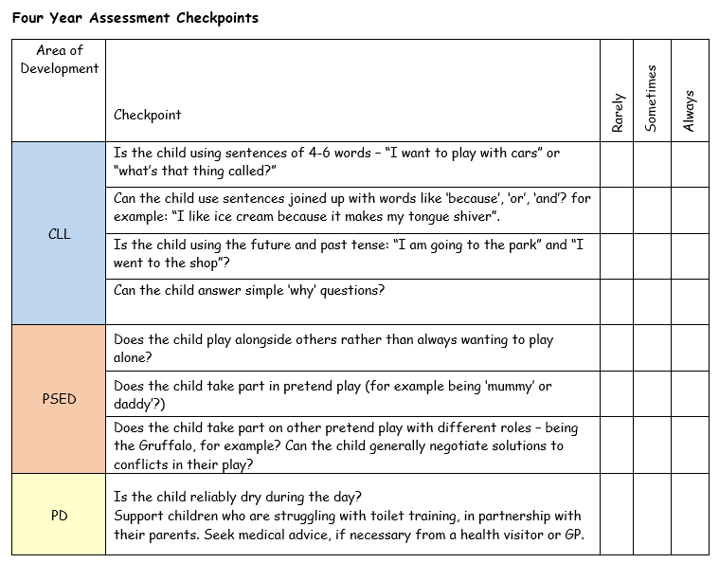
Preschool Long Term Plan

Slide 16
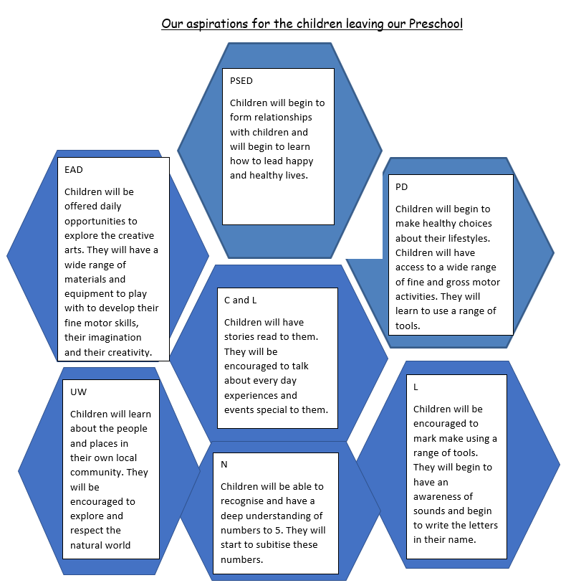

Slide 17
Preschool Long Term Plan
 | Autumn 1 | Autumn 2 | Spring 1 | Spring 2 | Summer 1 | Summer 2
General Themes | All About me! | Autumn | Traditional tales | growing | Mini beasts | The sea
Transition to Reception
Expressive Arts and Design Painting, 3D modelling, messy play, collage, cutting, drama, role play, threading, moving to music, clay sculptures, following music patterns with instruments, singing songs linked to topics, making instruments, percussion. Children to produce a piece of art work each half term to be displayed for ‘Celebration wall’ for school / parents to show how drawings have developed - lots of links to Fine Motor Skills. Children to explain their work to others. Children will have opportunities to learn and perform songs, nursery rhymes and poetry linked to their work / interests and passions. | Shared assembly time with Taw and Codden classes on Wednesday and Friday afternoons led by EYFS staff. Pre school staff to support school starters settle into Codden class. Taw and Codden classes to eat lunch together in the school hall. Shared garden space and free flow Fridays. All About Me sheet brought into school by families about their child. Settling in parents meeting. | Shared assembly time with Taw and Codden classes on Wednesday and Friday afternoons led by EYFS staff. Taw and Codden classes to eat lunch together in the school hall. Shared Christmas party and Christmas songs with Taw and Codden Classes. | Shared assembly time with Taw and Codden classes on Wednesday and Friday afternoons led by EYFS staff. Taw and Codden classes to eat lunch together in the school hall. | Shared assembly time with Taw and Codden classes on Wednesday and Friday afternoons led by EYFS staff. Taw and Codden classes to eat lunch together in the school hall. | Shared assembly time with Taw and Codden classes on Wednesday and Friday afternoons led by EYFS staff. School starters in Taw encouraged to get own lunches in the hall at lunch time and return dirty dishes. Shared Ugly Bug Ball with Taw and Codden Class. | School Starters in Preschool to have Assembly in Codden class with DC and LP, the younger children to have assembly with preschool staff on Wednesday and Friday Afternoons. LP/DC visit new school starters in their settings if different from school pre school.LP/DC Meet parents of SEN chn starting school. Shared pirate day with Taw and Codden class. Current Reception Children to attend a transition session with new class teacher. School starters in Taw encouraged to get own lunches in the hall at lunch time and return dirty dishes.

